Slide 1


BSD 414:
DESIGN THINKING
Lecture 4: Define in Design Thinking
Notes:
The design thinking process is used by people working in STEM as a method to solving problems. Major organisations often have a ‘Design Thinking’ Team or ‘Innovation’ Team who work solely in this way, such as Transport for London, Uber Eats, AirBnb, Netflix, or OralB. It is an interative process, that challenges assumptions and develops open minded creativity. In its entirety it has 6 steps, and normally focuses on a user or a particular group. The stages are: empathise, define, Ideate, prototype, test, implement. As students may not choose to focus their problem on a particular person, or group of people we have simplified the process to include 4 steps: define, ideas, prototype, test. The infographic on the slide shows that the testing should help then inform your idea to create a better prototype and test again. This iterative cycle then creates a better design in order to implement.

Slide 2

Definition
“Design thinking is a human-centered approach to innovation that draws from the designer's toolkit to integrate the needs of people, the possibilities of technology, and the requirements for business success.”
— Tim Brown, CEO of IDEO
Source and more information: https://voltagecontrol.com/blog/8-great-design-thinking-examples/

Slide 3
Group Discussion
Read through the notes on Define Stage of Design Thinking as shared on the Dashboard. Simulate the Definition stage of Design thinking in relation to the two case studies provided and make short notes for discussion
We Rejoin after one hour or so

Slide 4
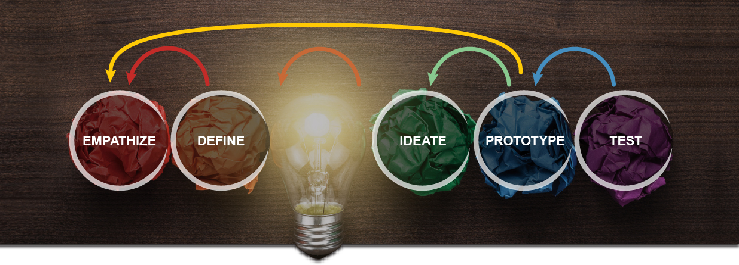
Design Thinking Process

Slide 5
Define

Slide 6
Define—State Users' Needs and Problems
Once the team accumulates the information, they analyze the observations and synthesize them to define the core problems. These definitions are called problem statements. The team may create personas to help keep efforts human-centered.

Slide 7
Define—State Users' Needs and Problems
Defining Stage:
In this phase, we collect and categorize information from the Empathize phase.
It’s here where we define User Personas and User Journeys.

Slide 8
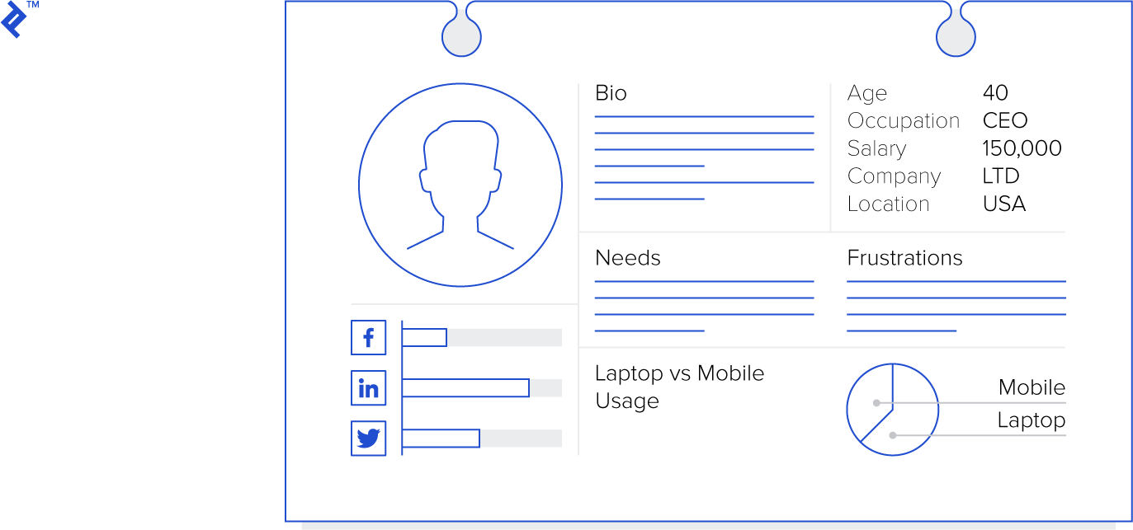
Define—State Users' Needs and Problems

Slide 9
Define—State Users' Needs and Problems
The dictionary meaning of define is to determine the identity and the essential qualities of a notion. In our case we wanted to define the following:
our ideal customers
their problems
the solutions to their problems
the needs and fears of our customers that we had to address

Slide 10
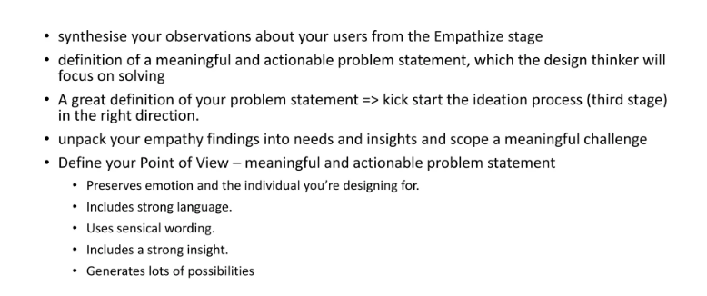
Define—State Users' Needs and Problems

Slide 11
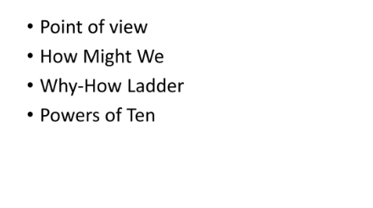
Define—State Users' Needs and Problems

Slide 12
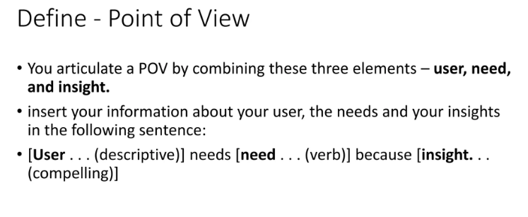
Define—State Users' Needs and Problems

Slide 13
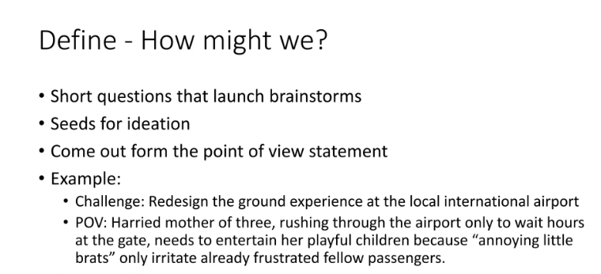
Define—State Users' Needs and Problems

Slide 14
Define—State Users' Needs and Problems

Slide 15
Define—State Users' Needs and Problems

Slide 16
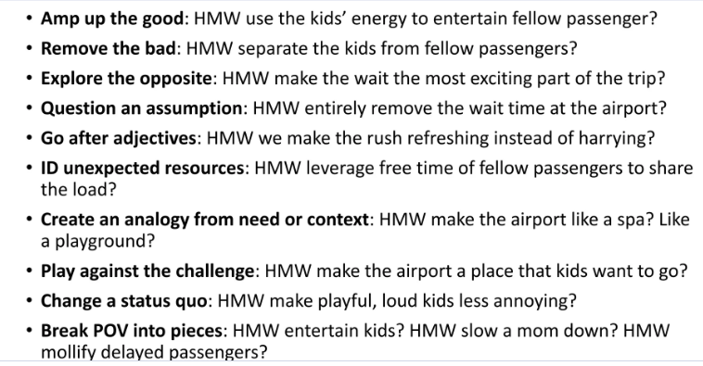
Define—State Users' Needs and Problems

Slide 17
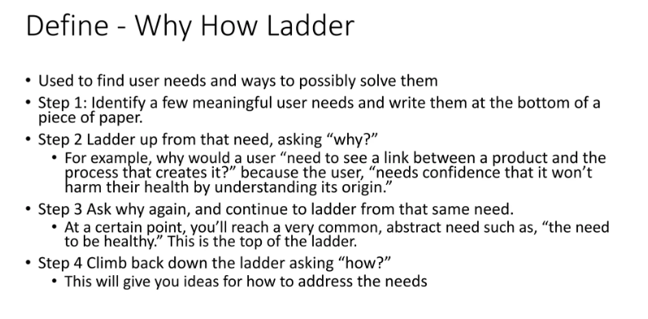
Define—State Users' Needs and Problems

Slide 18
Define—State Users' Needs and Problems

Slide 19
CONCLUSION
Designers synthesize the insights gathered during the empathize phase to define the key challenges and opportunities for Designing the desired product.

Slide 20
Case Studies 1
Background:
A public school district is facing challenges with outdated curriculum frameworks that fail to engage students effectively and meet their diverse learning needs. They aim to redesign the curriculum to promote student-centered learning and foster creativity, critical thinking, and collaboration.

Slide 21
Case Studies 2
Background:
A higher education institution needs to rapidly transition to remote learning due to the COVID-19 pandemic, but they lack the necessary infrastructure and resources to deliver engaging and effective online courses

Slide 22
Review Question
Simulate the Definition stage of Design thinking in relation to the two case studies provided

Slide 23


Notes:
The design thinking process is used by people working in STEM as a method to solving problems. Major organisations often have a ‘Design Thinking’ Team or ‘Innovation’ Team who work solely in this way, such as Transport for London, Uber Eats, AirBnb, Netflix, or OralB. It is an interative process, that challenges assumptions and develops open minded creativity. In its entirety it has 6 steps, and normally focuses on a user or a particular group. The stages are: empathise, define, Ideate, prototype, test, implement. As students may not choose to focus their problem on a particular person, or group of people we have simplified the process to include 4 steps: define, ideas, prototype, test. The infographic on the slide shows that the testing should help then inform your idea to create a better prototype and test again. This iterative cycle then creates a better design in order to implement.

